Slide 1
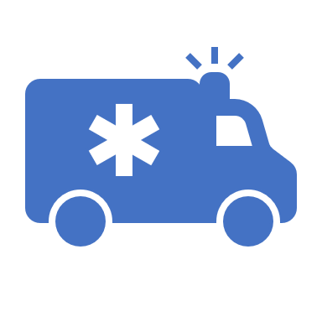
WHO’S NEXT
Emerge Connect

Slide 2
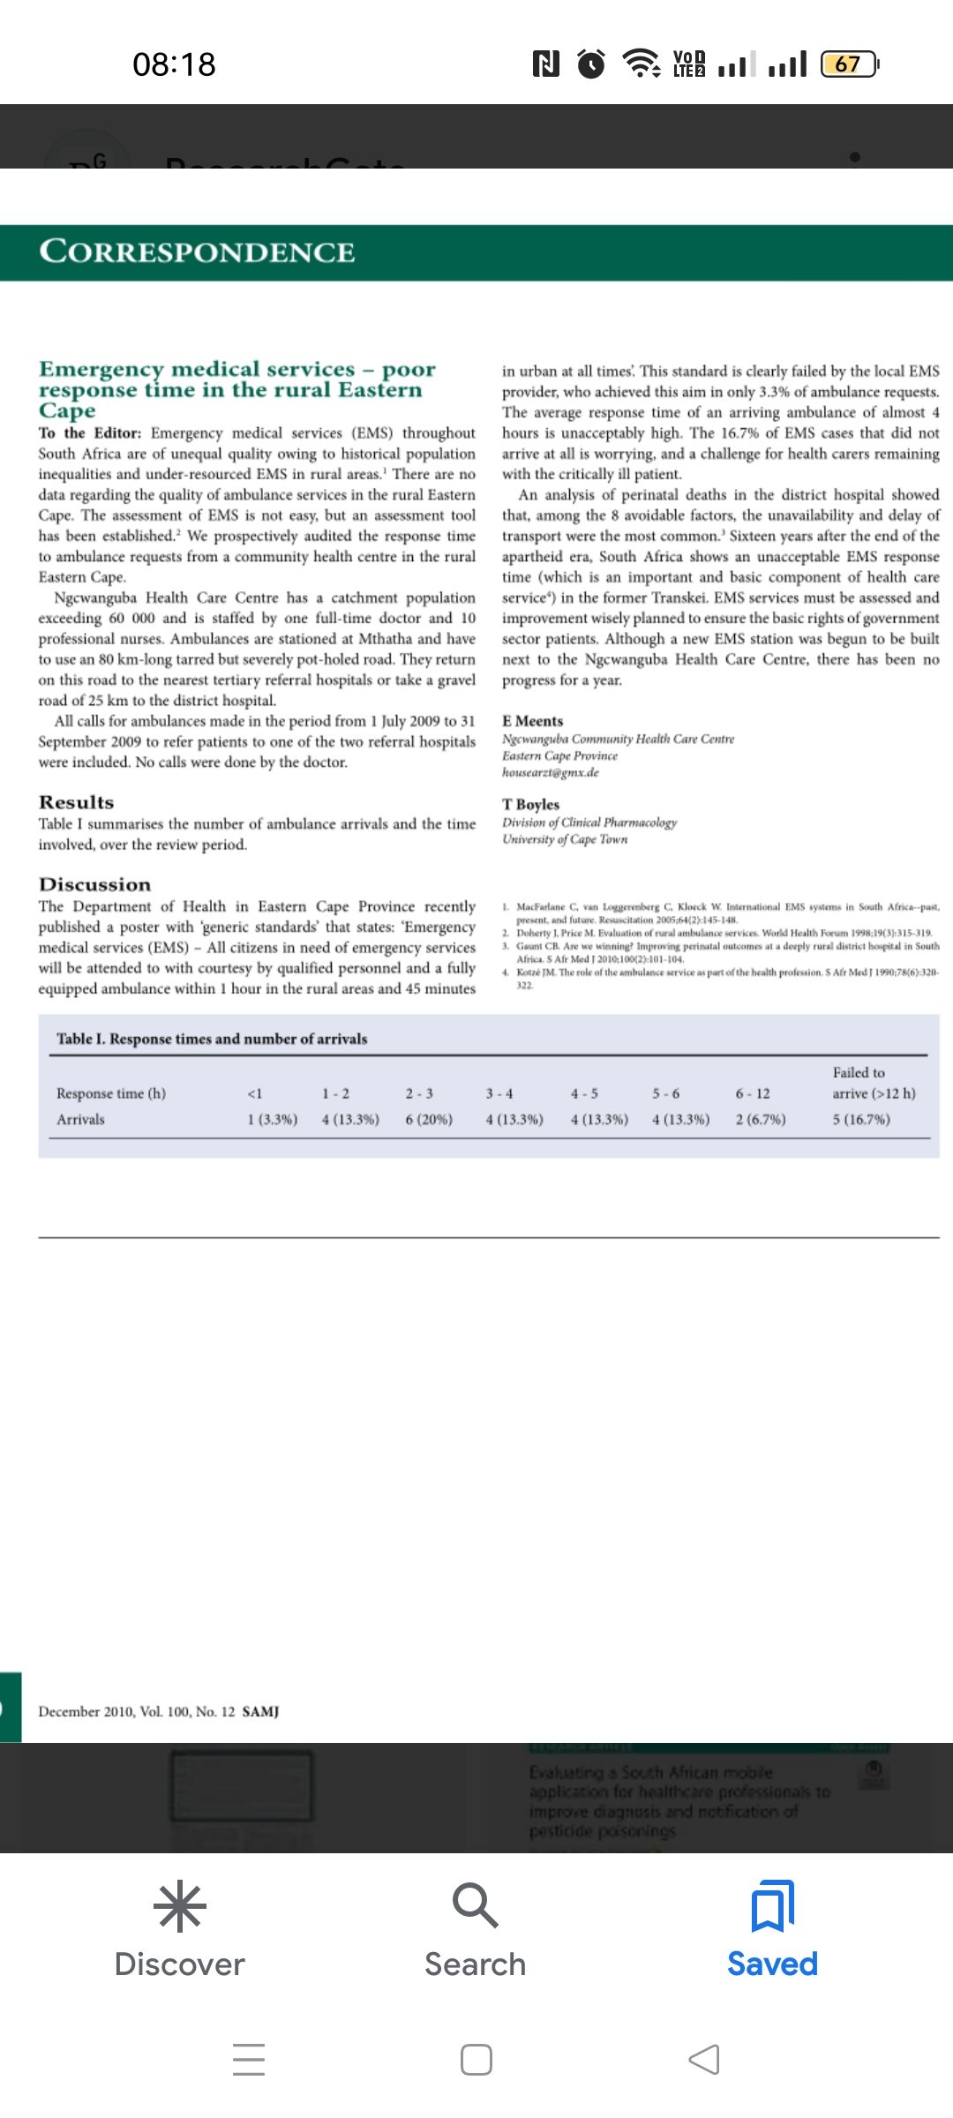

Slide 3
Problem Statement
We have noticed that the turn around time for emergency services (namely the health and fire department) is currently too long , so here is a run through the process you undergo when in distress and require emergency services
A person calls
The main call centre receives this call
They ask for details from the person and the type of emergency they require
The person is then transferred to a branch close to them
They undergo the process of providing the details again
The dispatchment process begins

Slide 4
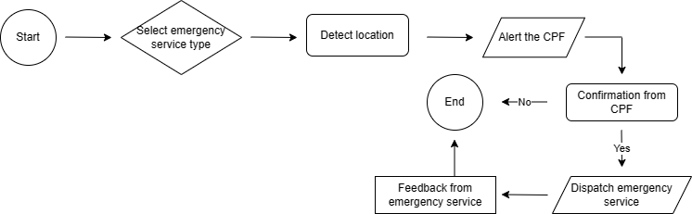
Functionality
In a matter of life or death how does our application reduce the tedious process above and still meet the needs of our customer.
Our app works with pre-loaded demographic information acquired during sign up from the user.
When in distress,

Slide 5
Mitigation of false alerts and providing safety to emergency vehicles
Our goal is to ensure safety during emergency dispatchment by working closely with the CPF. However, we face challenges in overcrowded areas where streets are barely visible, making it difficult to reach patients in distress. To address this, our application immediately notifies a CPF member when we receive an alert. The CPF member then assists us in confirming whether the alert is genuine and helps emergency personnel identify the household in need of assistance. This also helps prevent emergency vehicles from being targeted by hijackers. In cases where the community member has collapsed, the CPF member can arrive first and still confirm whether they need assistance.

Slide 6
Functionality
Our system has added features, it monitors the arrival of the personnel at the emergency location, updates once the emergency has been attended to and finally indicates the number of free emergency vehicles at different areas.
Ultimately our goal has been achieved but in an improved way. Our application has added features that users can access, these include first aid tips, and fire rescue tips .

Slide 7
Technologies used
Figma
C#
Security considerations
Data encryption
Input validation

Slide 8
Business Aspect
Target Market
People who are in need of emergency services
How are we reaching out to our target market?
Advertising – utilise social media platforms
Word of mouth
Notice boards
Funding
Municipality
Accessibility
Zero rated
Different departments (health care , fire department)
Municipality
Community
Network providers
Google maps
Key partners

Slide 9
Mitigation of false alerts and providing safety to emergency vehicles
Our goal is to ensure safety during emergency dispatchment by working closely with the CPF. However, we face challenges in overcrowded areas where streets are barely visible, making it difficult to reach patients in distress. To address this, our application immediately notifies a CPF member when we receive an alert. The CPF member then assists us in confirming whether the alert is genuine and helps emergency personnel identify the household in need of assistance. This also helps prevent emergency vehicles from being targeted by hijackers. In cases where the community member has collapsed, the CPF member can arrive first and still confirm whether they need assistance.

